Slide 1
Fraud Analytics
DSO 562
Spring 2018

Slide 2
1/11 Class 1 - Overview
My background
What we’ll cover during the semester
Grading, homework, projects
What is fraud
How to build fraud algorithms
Tax fraud example
Assignment Homework 1

Slide 3
Who Am I
Stephen Coggeshall, PhD Nuclear Engineering
Worked 11 years at Los Alamos National Lab doing nuclear fusion research
Began doing machine learning in 1990
Cofounded three analytics companies
CASA (1995) -> HNC/FICO (2000)
Los Alamos Computational Group (2002) -> Morgan Stanley (2004)
ID Analytics (2002) -> LifeLock (2012) -> Symantec (2017)
Chief Analytics and Science Officer IDA, LifeLock, retired
Oversee technology, analytics for risk and marketing analytics
Taught Fraud Analytics USC 2016, 2017, UCSD 2017

Slide 4
Fraud Problems I’ve Worked On
IRS tax preparer fraud
Credit card transaction fraud
Credit card merchant fraud
Healthcare claims fraud and abuse
Identity fraud for
Financial services (credit cards, loans, payday loans…)
Telecommunications (Sprint, TMobile, ATT, Verizon…)
Government agencies (SSA, VA, IRS)

Slide 5
What We’ll Cover
What are the types of fraud, how is it committed
Principles in catching fraud
Various algorithmic approaches to fraud detection
You will work on 3 projects and build fraud algorithms, 1 unsupervised and 2 supervised fraud algorithms

Slide 6
Outline of Semester (Syllabus)

Slide 7
Survey room for background, skills, experience
What undergraduate degrees
What programming skills (SAS, R, Matlab, Python…)
What business experiences (jobs, internships…)

Slide 8
Define Fraud
Fraud:
A wrongful or criminal deception intended to result in financial or personal gain
Intentional misrepresentation in order to improperly receive something of value
Give Examples
For each, where/how does the problem happen
How big is the problem
Who pays for/is harmed by it

Slide 9
High Level Process for Building a Fraud Algorithm
Understand the nature of the problem
Gather and explore the data
Design overall modeling structure (inputs, outputs, training, testing, how will be evaluated, implemented)
Design and build variables (entities, profiles)
Select algorithm, train, test, finalize
Implement, monitor, improve
Use common sense all the time

Slide 10
First Fraud Problem: Tax Preparer Fraud
What is the business problem:
Find fraud committed by tax preparers, not necessarily tax payers
What was the situation when I took over the project:
Team building supervised fraud models looking for unusual tax returns
Using linear, logistic regressions, various clustering methods
Scored hundreds of thousand returns, sent few hundred to IRS to investigate
IRS kept saying “nothing there”
What would you do?

Slide 11
Look at data. What fields are available?
Name, address
Dependents
You and spouse SSN
Filing status
Income
Adjustments to income
Refund amount (+/-)
PTIN
EIN
Self employed
Preparer’s name
ABA routing number
Account number
Occupation
Date
Estimated tax penalty
Tax credits

Slide 12
Tax Preparer Fraud Solution Approach
First fully understand the business problem:
seeking tax preparer, not tax payer fraud
Fully understand current flagging and investigative process:
Investigators looking for connections between returns, all manual and in their heads
Simple solution:
Build a fraud score for each return
Aggregate summary information at the tax preparer level
Sort tax preparers by a summary fraud score and present summarized info to investigators in an efficient way

Slide 13
Homework 1: Examples of Fraud Due 1/18 noon
List 5 kinds of fraud, for each describe
Nature of the problem (industry, product…)
Size of the problem ($’s, volumes, importance…)
Who commits the fraud (individuals, groups, professionals…)
How the fraud is committed
Who is harmed? Who pays for the losses?
How is the problem solved today?
Possible examples: EITC tax payer fraud, healthcare fraud, credit card fraud, money laundering, mortgage fraud, identity theft, check fraud, pyramid schemes, penny stocks…

Slide 14
Homework 1: Example
Fraud Type | Nature of problem | Size of Problem | Who commits | How done | Who harmed | How solved today
Tax prepayer fraud | Invention or manipulation of info consistently across many returns | Few hundred convictions/year, around $500,000 to a million loss per conviction on average. | Tax preparers | Tax preparers conspire to submit many fraudulent returns, typically with a common theme like invented income/losses, added dependents, systematic deductions… | Tax payers | Rules and algorithms, human investigations
EITC tax payer fraud | Falsify return to maximize EITC payment, average about $3,000 | About 25% of EITC payment, about $16 billion/year | Tax payers | Income increased or reduced to get into sweet spot for EITC payment | Tax payers | Rules and algorithms, human investigations

Slide 15
1/18 Class 2 – Fraud Processes
Review last week
Look at Homework 1
Concepts, definitions
How to build fraud detection solutions
How to use fraud scores
Kinds of fields, plotting distributions
Look at Project 1 data

Slide 16
Look at Some Homework 1s

Slide 17
Some Concepts and Definitions
Forensic accounting – after-the-fact batch examination of a collection of events or data
Real time fraud algorithms – process of scoring a flow of events one at a time. Can only examine past events.
False negatives – bad events that you miss.
False positives – good events that you incorrectly catch.
Reject inference – the process of inferring the outcome of events that you didn’t completely experience.

Slide 18
Kinds of Fraud Algorithms
Expert rule systems, filters
Statistically built rule systems, filters (CART)
General statistical models, ML models
Unsupervised
Autoencoders (linear, nonlinear), Mahalanobis distance, unsupervised clustering (k means, fuzzy c means, SOM…), z score outliers
Supervised
linear models: LinReg, LogReg, PCR, PLS…
Nonlinear: CART, neural nets, forests, boosted trees, SVM, Bayesian

Slide 19
How to Approach a Fraud Solution
Listen, ask questions, fully understand business goals
Understand the fraud dynamics, as many methods as possible (start thinking about entities and variables)
How will solution be implemented, used, maintained, measured, evaluated?
Can you provide automation to what the investigators are already doing
What data is available, historical?, going forward?, how collected, stored, labels?
Design the problem framework: regression/classification?, real time/batch?, what time scale, what are the inputs/outputs, how to structure the data
Think broadly about the possible data available. Can more data be collected, purchased? Census, phone book…? How to handle lack of historical data?

Slide 20
General Solution Process
Assemble data, time frames, populations, exclusions, decide fields
Label data: work with business to define good/bad
Perform basic statistics: field populations, percentages, field distributions, Data Quality Report (DQR)
Interact with domain experts, decide entities and construct expert variables
Decide training, testing, out of time samples
Build preliminary models. Examine inputs: do they make sense? Beware of models that perform too well.
Iterate preliminary models with business leaders. Are all the inputs OK?
Finalize models, deliver, document
Implement and monitor going forward

Slide 21
Process for Product Applications, Transactions, Claims…
Through
The Door
(TTD)
Credit check,
eligibility
(score, algorithm)
Yes/OK
Fraud check
(score, algorithm)
Yes/OK
Approve
Book new account,
Pay claim or request
Approve transaction
…
No
No
FRAUD EXPERTS,
EXAMINERS
Decline
Manually review
Get external data
Make phone call
Send letter, email
…
Review
Yes/OK
Approve
Outcome generally known
Label as a good or bad
No
Decline
Note: “algorithm” can be rules, linear or logistic regression, or complex ML model
Don’t know truth
(leads to Reject Inference problem)

Slide 22
What Does Data Look Like?
Records, events
field1 field2 field3 … fieldn label
field1 field2 field3 … fieldn label
field1 field2 field3 … fieldn label
…
time
text, number, characters, symbols…
Name, address, $s, time, event type…
Use fraud algorithm
Fraud
Algorithm
Record
Score (likelihood of fraud)
Each records gets a score
field1 field2 field3 … fieldn label score
field1 field2 field3 … fieldn label score
field1 field2 field3 … fieldn label. score
…

Slide 23
Score Distribution
What if the score were just a random number from 0 to 1?
Score distribution for a uniform random number
Number of records at that score
0
Score
1
Typical score distribution for a fraud score:
Most records look OK
Number of records at that score
Small # records look bad
0
Score
1
Low likelihood of fraud
GOOD
High likelihood of fraud
BAD

Slide 24
How To Use Fraud Score
Build fraud model using historical data
Score new data records with model
Sort new records by the score
Work records in decreasing score order
Fraud
Algorithm
Record
Score (likelihood of fraud)
Number of records at that score
Investigate records from this end
0
Score
1
Low likelihood of fraud
GOOD
High likelihood of fraud
BAD
24

Slide 25
Kinds of Data Fields
Numeric
Could be integer (discrete) or continuous
There is a metric (concept of order and nearness)
Categorical
Examples: A, B, C… or Type 1, Type 2, Type 3…
These are different from numbers because there is no metric
Date/Time
20180118, 1/18/2018, 2018-01-18T14:22:38…
Text
Examples: John Smith, 111 Main Street…
Free text in sentences, paragraphs or a document
Just a string of characters like 0b9717s93f90g8r34
Others
Images, sound, video…

Slide 26
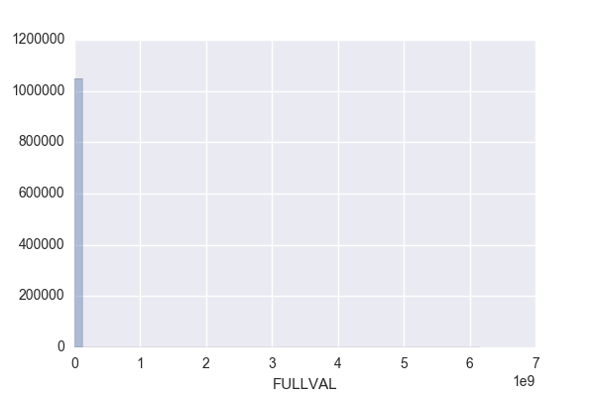
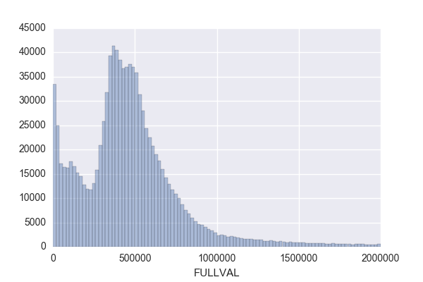
How to Look at a Numeric Field
Calculate the basic statistical properties
% populated, mean, standard deviation, max, min
Look at the distribution
This picture doesn’t show a lot of information
This picture is much better. It shows the nature of the distribution.

Slide 27
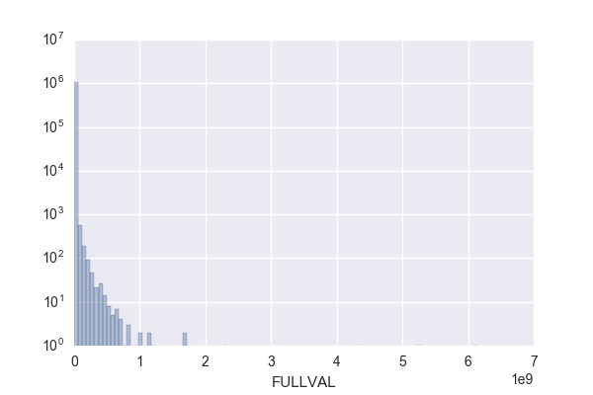
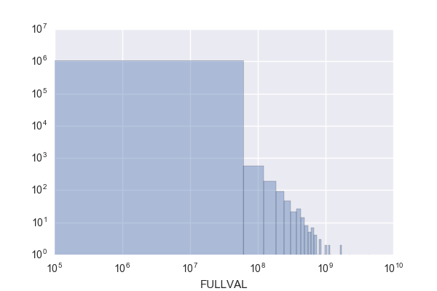
Use Good Choices of Ranges and Logs for Plots
First try, not good
Try a log y axis
Better choice of x range
Or a log log scale

Slide 28
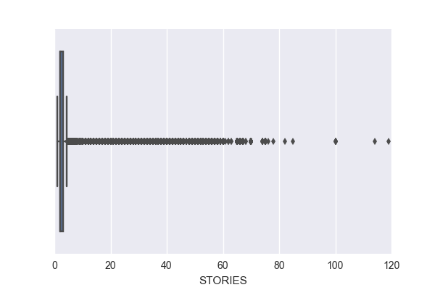
Can Start With a Boxplot for a Numeric Distribution
If your data has a difficult distribution, for example bad outliers, it’s sometimes hard to find a good scale. Try starting with a ”boxplot”
25% quartile through the 75% quartile
minimum
“maximum”
outliers

Slide 29
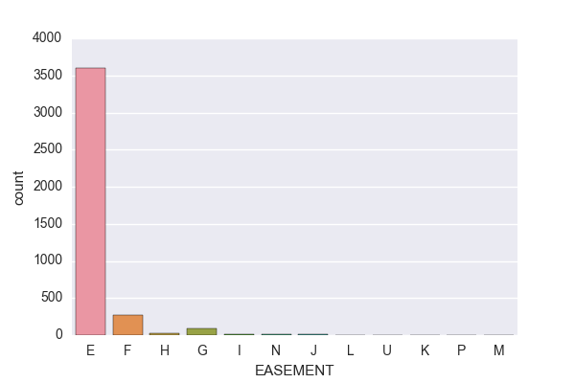
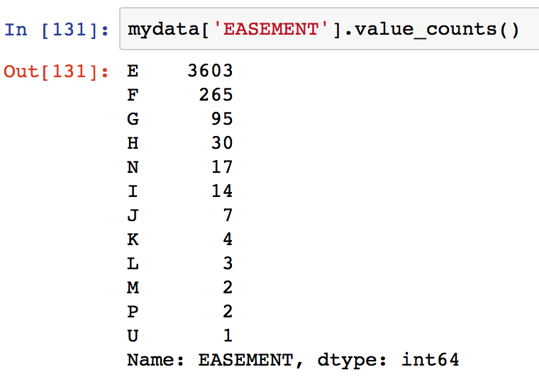
How to Look at a Categorical Field
Calculate the basic statistical properties
% populated, number of unique values
Look at the distribution, either as a histogram or a table

Slide 30
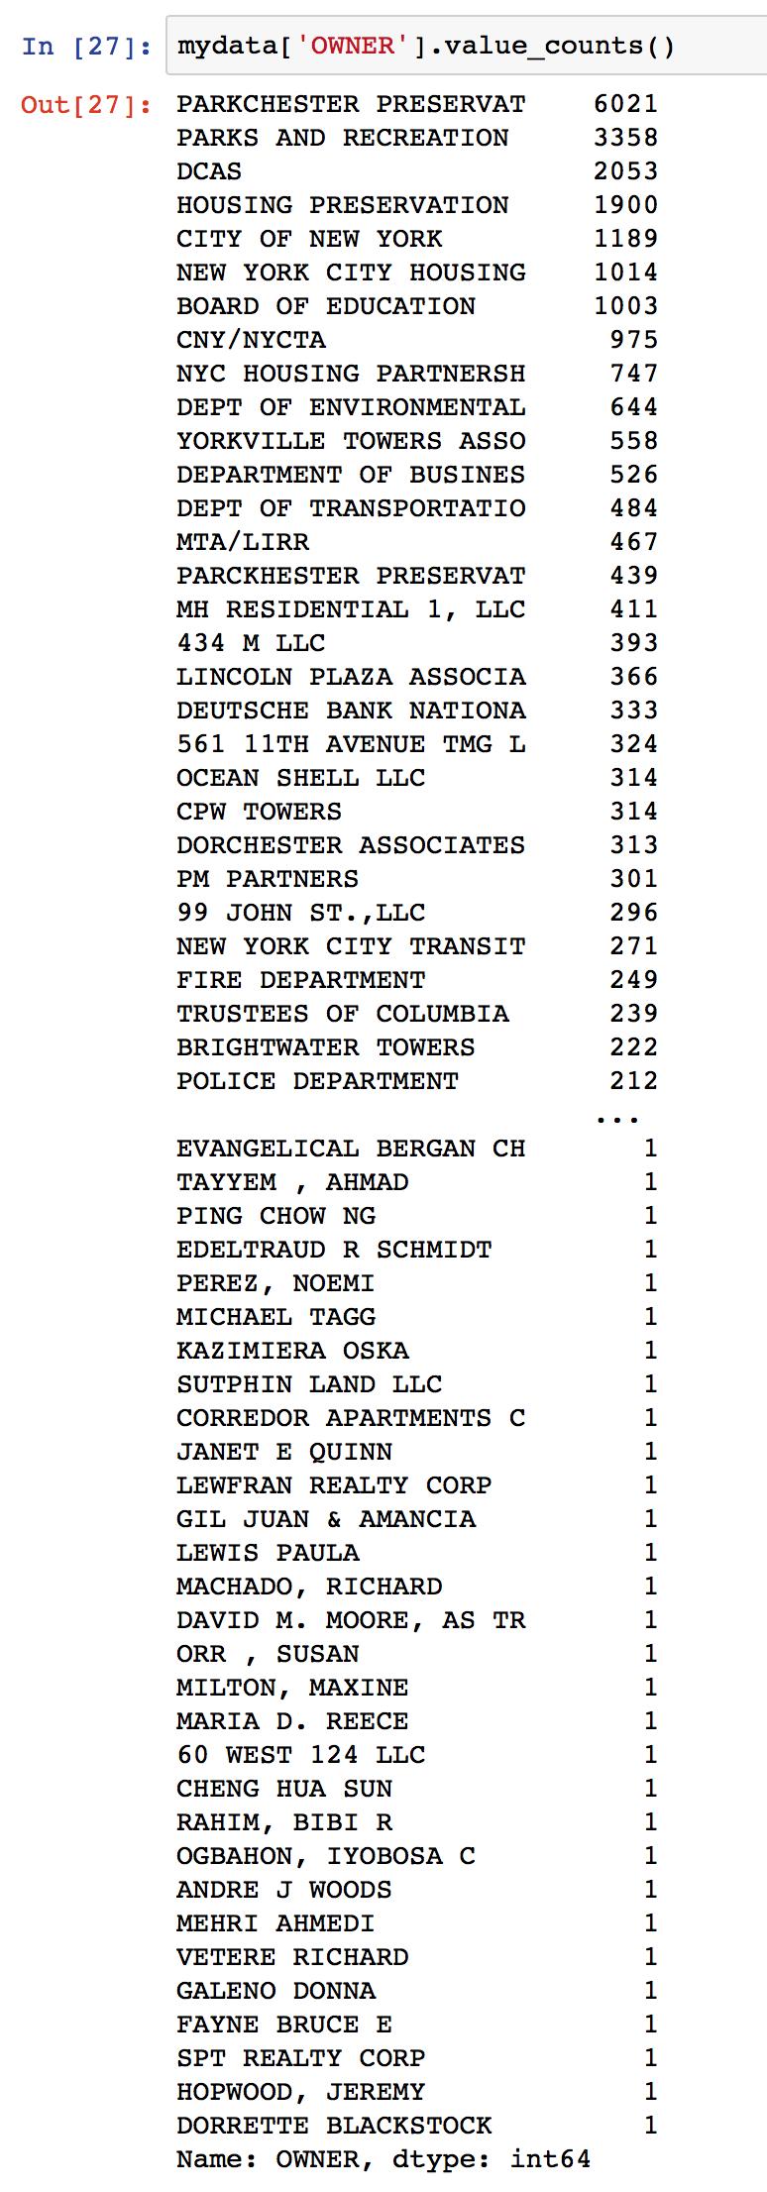
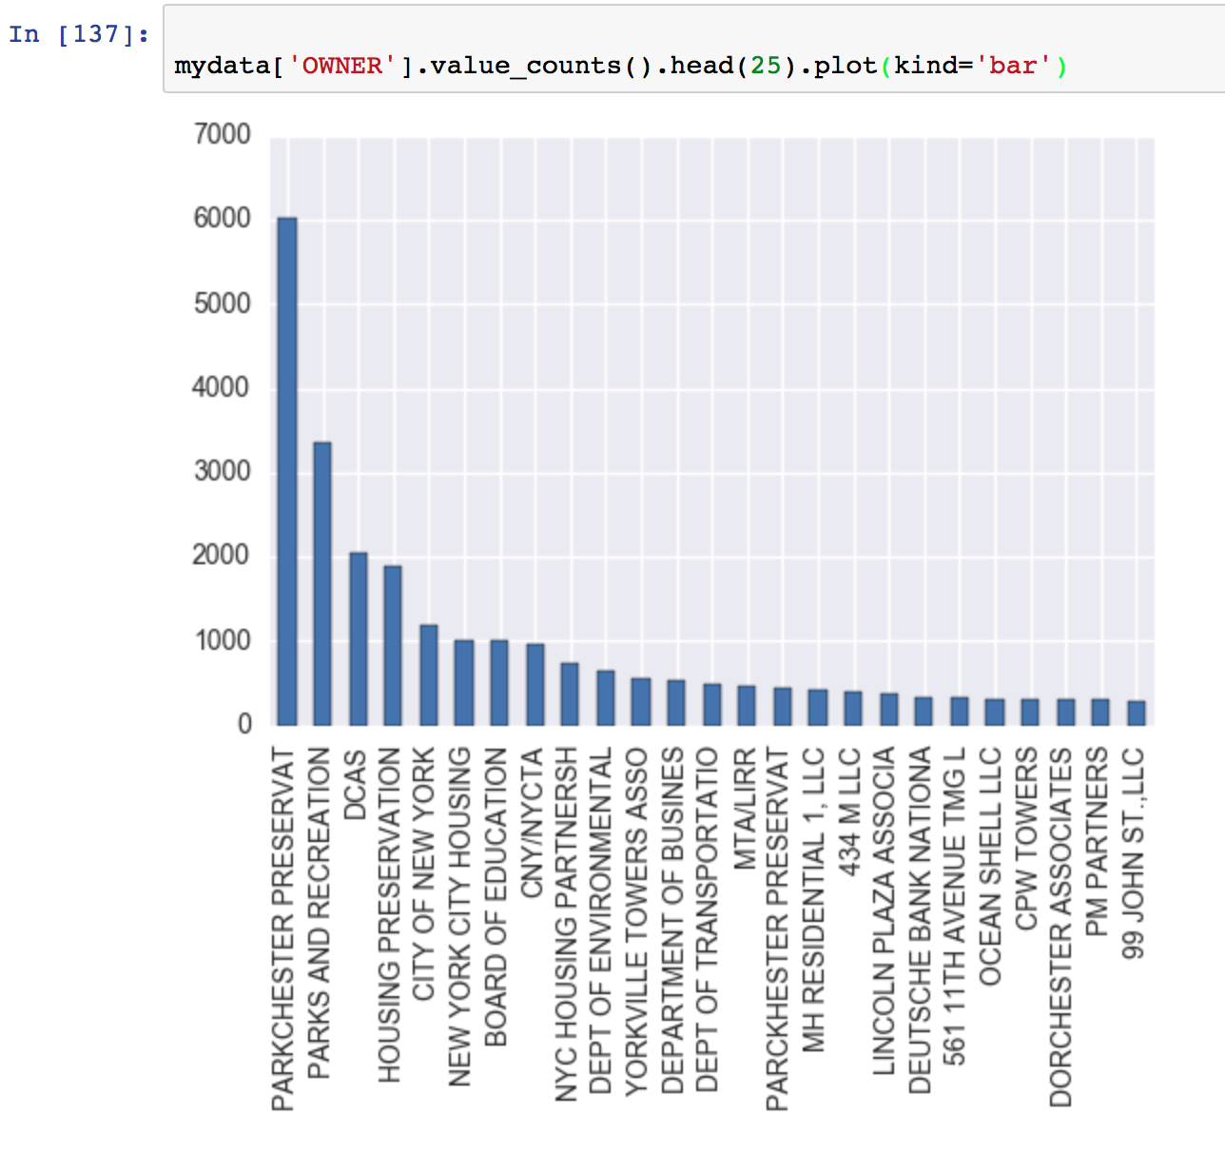
How to Look at a Long Categorical Field
You can print a partial list or a histogram of the top n values

Slide 31
Look At Project 1 Data
Homework 2:
Find 3 interesting/unusual things about Project 1 data
Due 1/25 noon
Here is a little information about the data for our homework and that we will be using for our first project. I don’t know much about the data. I found it here:
https://data.cityofnewyork.us/Housing-Development/Property-Valuation-and-Assessment-Data/rgy2-tti8
As far as I can tell
BBLE is a concatenation of 3 fields: BORO, BLOCK, LOT
AV abbreviation means Assessed Value
LT abbreviation means Lot
BLD abbreviation means Building

Slide 32
1/25 Class 3 – Data and Modeling Overview
Review last week
Look at Homework 2
Essence of statistical modeling presentation
How to approach and analyze data
How to do a Data Quality Report (DQR)
Assign Homework 3: DQR on NY data

Slide 33
The Essence of Statistical Modeling
What is a model
Kinds of models
What does a statistical model look like
How to build a model
Setting adjustable parameters
Building data records
Measures of goodness
Detection rate, false positives, KS, Mean square error, ROC

Slide 34
How To Approach Numeric Data
n+1 columns
x1 x2 x3 …. xn y
x1 x2 x3 …. xn y
x1 x2 x3 …. xn y
…
x1 x2 x3 …. xn y
n independent variables (x’s)
One dependent variable (y)
Many more rows than columns (m >> n)
The goal is y=F(x)
m rows
x1 x2 x3 …. xn
x1 x2 x3 …. xn
x1 x2 x3 …. xn
…
x1 x2 x3 …. xn
1) Look at columns, calculate
% populated
Min, max
Mean, standard deviation
Distribution
2) Calculate covariance and correlation matrices
Shows linear relationships among variables
First step in building linear models
X =
y
y
y
…
y
Y =

Slide 35
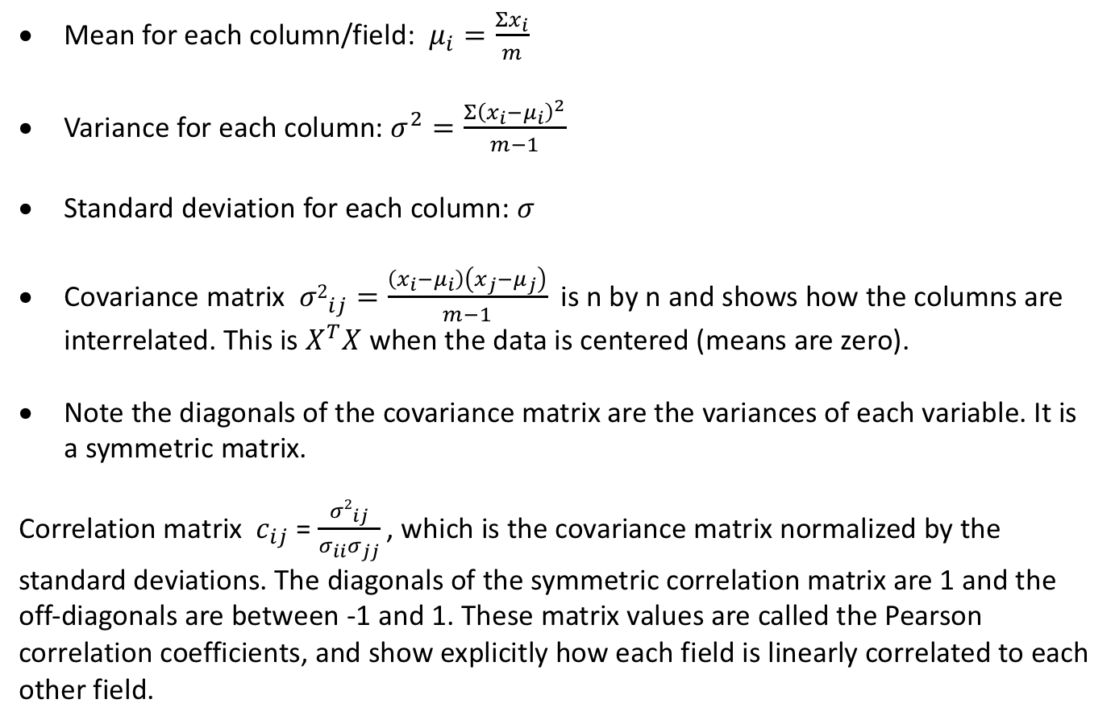
Basic Statistical Properties
Mean for each column/field: $μ_{i}=\frac{Σx_{i}}{m}$
Variance for each column: $σ^{2}=\frac{Σ{\left(x_{i}−μ_{i}\right)}^{2}}{m−1}$
Standard deviation for each column: $σ$
Covariance matrix ${σ2}_{ij}=\frac{\left(x_{i}−μ_{i}\right)\left(x_{j}−μ_{j}\right)}{m−1}$ is n by n and shows how the columns are interrelated. This is $X^{T}X$ when the data is centered (means are zero).
Note the diagonals of the covariance matrix are the variances of each variable. It is a symmetric matrix.
Correlation matrix $c_{ij}$ = $\frac{{σ2}_{ij}}{σ_{ii}σ_{jj}}$ , which is the covariance matrix normalized by the standard deviations. The diagonals of the symmetric correlation matrix are 1 and the off-diagonals are between -1 and 1. These matrix values are called the Pearson correlation coefficients, and show explicitly how each field is linearly correlated to each other field.

Slide 36
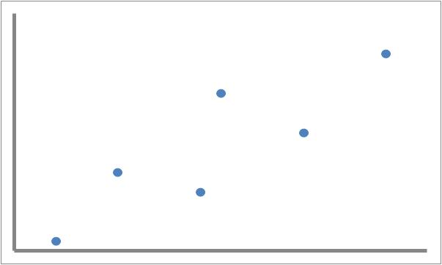
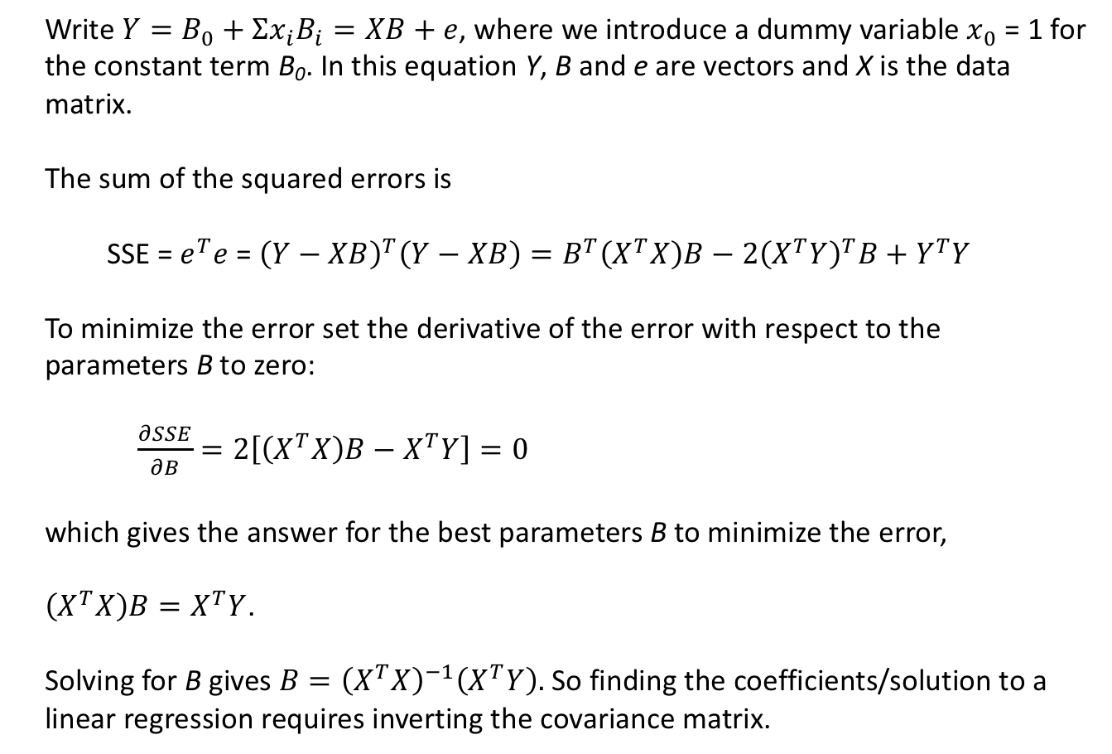
Linear Regression: a Simple but Common Model
Write$Y=B_{0}+Σx_{i}B_{i}=XB+e$, where we introduce a dummy variable $x_{0}$ = 1 for the constant term B₀. In this equation Y, B and e are vectors and X is the data matrix.
The sum of the squared errors is
SSE = $e^{T}e$ = ${\left(Y−XB\right)}^{T}\left(Y−XB\right)=B^{T}\left(X^{T}X\right)B−2{\left(X^{T}Y\right)}^{T}B+Y^{T}Y$
To minimize the error set the derivative of the error with respect to the parameters B to zero:
$\frac{∂SSE}{∂B}=2\left[\left(X^{T}X\right)B−X^{T}Y\right]=0$
which gives the answer for the best parameters B to minimize the error,
$\left(X^{T}X\right)B=X^{T}Y$.
Solving for B gives $B={\left(X^{T}X\right)}^{−1}\left(X^{T}Y\right).$ So finding the coefficients/solution to a linear regression requires inverting the covariance matrix.

Slide 37
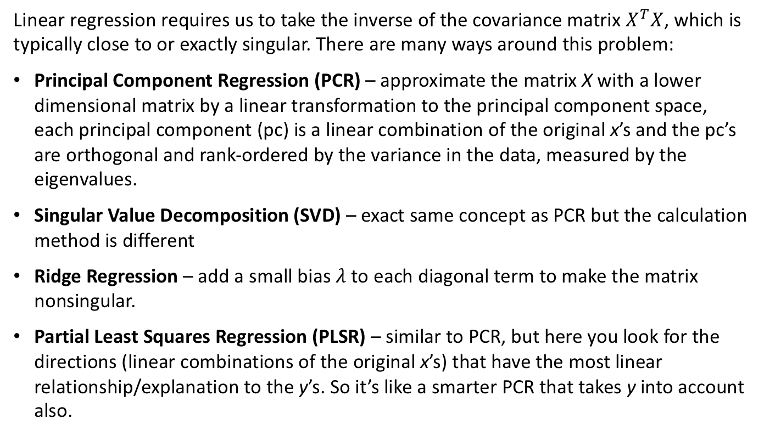
Linear Regressions Require Matrix Inversion
Linear regression requires us to take the inverse of the covariance matrix $X^{T}X$, which is typically close to or exactly singular. There are many ways around this problem:
Principal Component Regression (PCR) – approximate the matrix X with a lower dimensional matrix by a linear transformation to the principal component space, each principal component (pc) is a linear combination of the original x’s and the pc’s are orthogonal and rank-ordered by the variance in the data, measured by the eigenvalues.
Singular Value Decomposition (SVD) – exact same concept as PCR but the calculation method is different
Ridge Regression – add a small bias $λ$to each diagonal term to make the matrix nonsingular.
Partial Least Squares Regression (PLSR) – similar to PCR, but here you look for the directions (linear combinations of the original x’s) that have the most linear relationship/explanation to the y’s. So it’s like a smarter PCR that takes y into account also.

Slide 38
What is a Data Quality Report (DQR)?
A DQR is a preliminary quantitative analysis that explores and documents the basic characteristics of a data file
It is
Basic info about the file (how many records, time period, source…)
Summary statistics for each field
Percent populated
Numeric: min, max, mean, sd, distribution/histogram
Categorical: # values, histogram or table of values, top several values
Homework 3: Do a DQR of the NY property data
Due 2/1 noon

Slide 39
Look at DQR Example

Slide 40
2/1 Class 4 – Entities, Unsupervised Fraud Models
Review last week
Look at Homework 3
Entities, groupings, variables
Methods for unsupervised anomaly detection
Assign Project 1
Homework 4 – count the records for John Smith in the NY property data

Slide 41
Entities, Groupings
Definition: An Entity is a thing with a distinct and independent existence
Example entities:
Person, doctor, patient, procedure, doctor specialty, home address, phone #, email address, SSN, account #, tax preparer, zip code, time (day, hour of day…), merchant…
Identifying and using particular entities is fundamental in solving fraud problems
Group/link records by entities to create special variables or build entity profiles

Slide 42
Back to Tax data. What entities should we pay attention to?
list
Name
Address
Dependents
You and spouse SSN
Filing status
Preparer’s name, #
ABA routing #
Account #
Tax $ amount
Date

Slide 43
Healthcare data. What entities should we pay attention to?
list
Provider (doctor, nurse…)
Patient (SSN)
Insurance #
Clinic
Procedure
Time
Insurance plan type
Diagnosis
Prescription
address

Slide 44
Credit card transaction data. What entities should we pay attention to?
list
Account/card #
Merchant name
Merchant type
Bank name
Transaction $ amount
Merchant location (country, city, zip)
Day/time
POS entry mode (e-commerce, swiped, mail/phone order, chip)

Slide 45
Product application data. What entities should we pay attention to?
list
SSN
Name
Address
Application date/time
Phone number
Date of birth
Email address
IP address
Device ID

Slide 46
Entities, Groupings, Profiles, Variables, Link Analysis
For many modeling problems including fraud we build variables using entities and groups
This requires us to do exact or fuzzy matching on fields between records (hence Homework 4)
We use these to
Aggregate information by entities and groups
Normalize fields by group-specific statistics
Construct graph-based linking variables
Build profiles of entities

Slide 47
Example Variables Using Entities, Groupings, Profiles, Linking
Tax preparer: Aggregate records by tax preparer, calculate summary statistics for each preparer, sort by average fraud score
Normalize records by the averages for their group: tax class, zip code, borough…
Link/group records by owner, SSN, account #, address, phone #, email, device id, ..., then
Build variables using the typical or recent behavior of that entity/linking key: # transactions, average $’s, velocities, typical merchants…

Slide 48
What is a Profile?
A profile is a statistical summary of the typical behavior/characteristics of an entity
Credit card account
Typical merchants
Gas
Grocery
Travel
Online shopping
Time of day
8 am – 5 pm: 30%
5 pm – 10 pm: 60%
10 pm – 8 am: 10%
Average purchase: $87
Stdev purchase: $73
# purchases/day: 2.4
Doctor
Typical procedures
Office visit
Hand x ray
Finger surgery
Reconstruction
Work location
Office
Clinic 1
Hospital 1
Clinic 2
Average bill: $123
Stdev purchase: $94
# procedures/day: 35

Slide 49
Use Linking or a Profile?
Profile method builds the aggregations with a moving average method. Requires memory locations for each profile and update procedures.
Linking method constructs the link-lists and variables on the fly, as needed. Requires access to historical records and fast lookup/calculations.

Slide 50
How to Handle Missing Field Values
“Missing” can be a relevant value for a categorical variable.
Ignore the records that have a missing field? – not a good approach…
Replace the missing field value with something reasonable:
Build a model to predict the missing value given the other field values (usually too complicated)
The average or most common value of that field over all records (note – this is a simple model)
The average or most common value of that field over a relevant subset of records:
Select one or more other fields that you think are important in determining the missing field
Bin the selected field(s) into categories
Replace the missing field with the average or most common value for its binned or other appropriate group
Given data:
Record
# stories
sq feet
Zip
value
Fill in with
Average value across all records, or
Average value for records in zip 22042, or
Average value for all records with # stories = 3, or
Average value for all records in zip 22042 and # stories = 3
…
Fill in with
Average # stories across all records, or
Average # stories for records in that zip
…
1
2
3
4
5
6
7
8
9
2
1
3
3
2
NaN
4
3
2
294
495
3847
9278
129
948
847
1029
947
22041
22043
22042
22041
22052
22041
22043
22052
22051
1032
539
NaN
4837
462
583
2094
7632
489

Slide 51
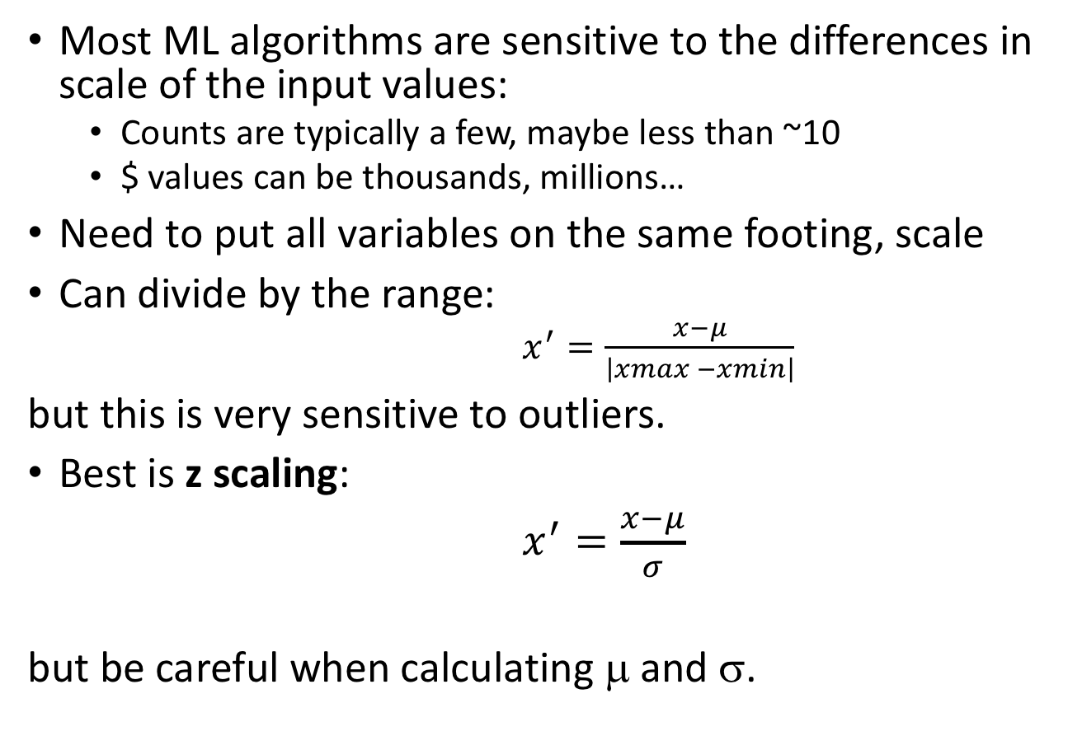
How To Scale Data
Most ML algorithms are sensitive to the differences in scale of the input values:
Counts are typically a few, maybe less than ~10
$ values can be thousands, millions…
Need to put all variables on the same footing, scale
Can divide by the range:
$x^{′}=\frac{x−μ}{\left|xmax −xmin\right|}$
but this is very sensitive to outliers.
Best is z scaling:
$x^{′}=\frac{x−μ}{σ}$
but be careful when calculating μ and σ.
Don’t do this
Do this

Slide 52
Another Way To Scale: Quantile Binning
The idea is that we transform a variable or score into it’s quantile rankings. This is used frequently when we want to scale the outputs from several models so we can combine them.
Bin the data into bins of equal population but unequal width
Replace the original values (variable or score) with the bin #
Now all the variables/scores are on equal scales
It’s bets to use a fairly large number of bins, like 1000
For example, 20 bins:
Number the bins
data distribution
5%
5%
5%
5%
5%
1
3
…
14
16
17
18
19
20
2
15

Slide 53
How To Handle Outliers
What is an outlier? Typically it’s a record with a field value that’s more than a few standard deviations (stdev) from normal.
But the calculation of the stdev can be affected by outliers, so be careful.
Throw away outlier records. Not OK for fraud pbms.
Use ML methods robust to outliers (e.g., trees)
Push outliers in something like +- 4 stdev’s. Should do by iteration.
For fraud problems, probably best to leave outliers as they are. They will then be flagged by the algorithm.

Slide 54
How to Encode Categorical Variables
Let’s say you have a field x that can take values A, B, C…
How do you encode these categories A, B, C… into numbers to go into a modeling algorithm?
Ordinal coding: Assign an integer to each category:
[A, B, C…] -> [1, 2, 3…]
Problem: many modeling algorithms assume there is a metric (1 is closer to 2 than 3)
Dummy, one hot: Expand the category list into new variables:
[A, B, C] -> x1, x2, x3… with binary values. So a record with value “B” -> 0,1,0,0…
Problem: explodes dimensionality, which is the opposite of what we want in modeling
Other dimensionality expanding: contrast, Helmert, GLM, comparison…
Risk tables: For each possible category assign a value
No dimensionality expansion (each categorical variable becomes one continuous variable)
Several choices to use for the value:
Average of the dependent variables for all records in that category (most common, “risk table”)
Log of the average
An information theoretic value like mutual information, entropy, KL distance.
Good – direct encoding to what you’re trying to predict
Bad - loss of interaction information
Don’t do this
Do this

Slide 55
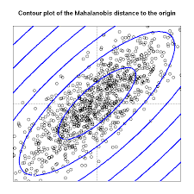
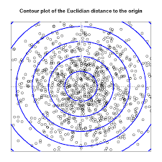
Mahalanobis Distance
Which point is more anomalous, the red or green?
The Mahalnobis distance takes into account the different scales and correlations. It draws equal contours by scaling based on the correlations and different standard deviations. This is also called “whitening” the data (without rotation).
X2 – time since last event
X1 – distance from home
The Mahalanobis distance from the center is the same as first transforming to the Principal Component space and scaling by the eigenvectors, or first PCA then z scaling.

Slide 56
Remember That Rotation is a Linear Transformation of Coordinates
x₂
x₂’
x₂
x₁’
x₁
x₁
Introduce a new coordinate system x₁’, x₂’ that is a rotation through angle θ.
The original points (x₁,x₂) can be written in terms of the new coordinates through a simple linear transformation:
x₁’ = x₁ cos θ − x₂ sin θ
x₂’ = x₁ sin θ + x₂ cos θ

Slide 57
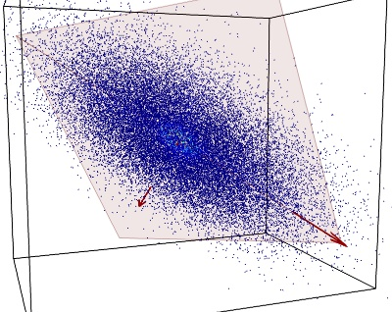
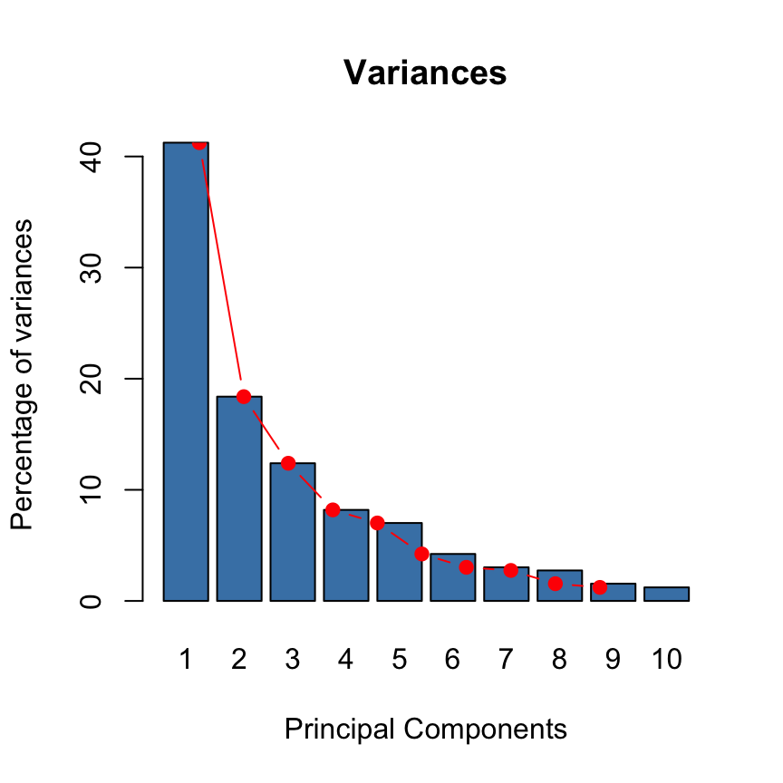
Principal Component Analysis and Regression (PCA, PCR)
PCA finds the dominant directions in the data
The PC’s are orthogonal, and ordered by the variance (spread) in their direction
The magnitude of the PC’s are the eigenvalues of the PC’s
The eigenvalues are proportional to the variance in that PC’s direction
PC2
PC1
One can look at the decaying of the eigenvalues and select a subset of the PC’s as a subspace to work in. One can then regress in this PC subspace. That’s PCR.

Slide 58
Methods for Unsupervised Models
Unsupervised models are ones where we don’t have labeled data.
Most unsupervised modeling is about finding structure or clusters in the data
But for fraud it’s about finding outliers:
Find the right space (expert variables, as low dimensionality as possible)
Talk to experts, build expert variables
Remove correlations, do linear transformations (e.g. PCA)
For fraud, sometimes clustering/grouping first is important
Within each cluster
Use Mahalanobis distance, or
zscale, PCA, z scale, heuristic function of z scores

Slide 59
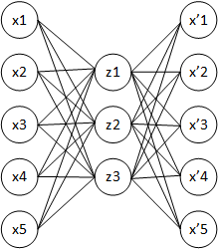
Another Unsupervised Model Method
Use an Autoencoder:
This is nonlinear and thus more general than the previous methods (PCA, Mahalanobis), which are linear
Train the model to reproduce the original data
The reproduction error is a measure of the record’s unusualness, and is thus a fraud score
Original data records
Reproduced data records

Slide 60
Homework 4 – Count the John Smiths
In the NY property data, how many records have a person named John Smith as owner?
Submit an excel sheet with all the records you find along with your total count
Due 2/8 noon

Slide 61
Project 1
Build an unsupervised fraud model for the NY property data
Work in teams, about 5 to 7 people
Use proper methodology:
data cleaning, variable construction, algorithm
Write a professional report
Due 2/22 noon (3 weeks)

Slide 62
NY Property Data Investigation
We’ll be looking for anomalies in the data (strange, unusual values)
Some modes of property fraud
Assessed value too low (too high?)
Person claiming an exemption for more than one property (requires linking by person)
Claiming exemption on rental property (simple rule?)

Slide 63
How to Build an Unsupervised Fraud Model
Fully understand the problem: fraud mode, data…
Build special variables that look for the fraud mode, some variables using entities and groupings
Scale the variables, minimize dimensionality
Z scaling, PCA, ask experts…
Model variables are the z scores or rankings
Combine the model variables with a heuristic algorithm
sum of absolute z scores, z scores squared, max/mins…
Use an autoencoder, and the fraud score is the reconstruction error

Slide 64
Project Report Outline
Cover Page: Title, project team names, date.
Table of Contents.
Executive Summary (few paragraphs) high level summary of project and results.
Description of data (few pages) include most important (not all) distributions/histograms, put the full DQR in appendix).
Data cleaning steps (one or a few pages). How did you handle outliers, missing fields.
Variables (few pages) describe in complete detail the formulas and logic for creating all the model variables. Include a list of all variables.
Algorithms (one or a few pages) Completely describe the way the fraud score is calculated.
Results (few pages) Plot the fraud score distribution. Manually look at the top few records and describe why they look anomalous. Make sure at least a few examples look unusual and are not just obviously spurious or data errors.

Slide 65
2/8 Class 5 – Entity Matching
Review last week
Look at Homework 4 (John Smith)
Entity Matching
Names
Addresses
Entity Resolution
Fuzzy matching algorithms
Explore Project 1

Slide 66
Fuzzy Matching Algorithms
2) Match columns:
Are these two field values the same for all records?
x1 x2 x3 …. xn y
x1 x2 x3 …. xn y
x1 x2 x3 …. xn y
…
x1 x2 x3 …. xn y
1) Match field values:
Are these two particular field values the same for these two records?
2) Match records:
Are these two records values the same?

Slide 67
Some Fuzzy Matching Algorithms for Individual Field Values
Levenshtein edit distance – minimum # single character edits (insertion, deletion, substitutions)
Damerau-Levenshtein – Levenshtein plus transpositions
Jaro-Winkler: # single adjacent character transpositions
Hamming – % characters that are different (substitutions only)
N grams – a sliding window of n characters. Can count how many are the same between two fields.
Soundex – a phonetic ”sounds like” comparison (John, Djahn)
Stemming, root match – determine the root of the word and compare by roots
Field specific, ad hoc heuristic

Slide 68
Some Fuzzy Matching Algorithms for Columns
Linear correlation
Divergence
Kulback-Leibler distance (KL)
Kolmogorov-Smirnov distance (KS)

Slide 69
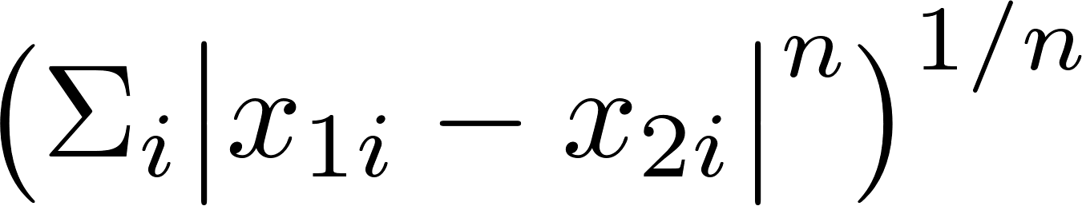
Some Multidimensional Distance Metrics to Match Records
How close are these data points/records?
y
x₁
x₂
x₂
x₁
D=
Euclidean, n=2 (L-2) (only useful after proper scaling)
Mahalanobis: z scaling then Eucledian
Minkowski, n general (L-n)
Manhattan, n=1: distance traversed along axes
Chebyshev, n very large (L-infinity): max along any axis

Slide 70
Reminder: How to Build an Unsupervised Fraud Model
Build special variables that look for the fraud mode, some variables using entities and groupings
Scale and minimize dimensionality
Z scale
PCA, keep top ~5 to 10 PCs; look at the eigenvalues and keep maybe up to 80%.
Represent each record in this new reduced space of the PCs
Z scale the data fields again
Combine the z scores with a heuristic algorithm
sum of absolute z scores, z scores squared, max/mins…
Or do an autoencoder on the z scaled PCs, and the fraud score is the reconstruction error

Slide 71
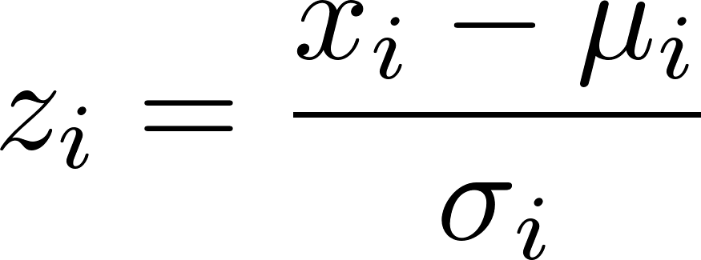
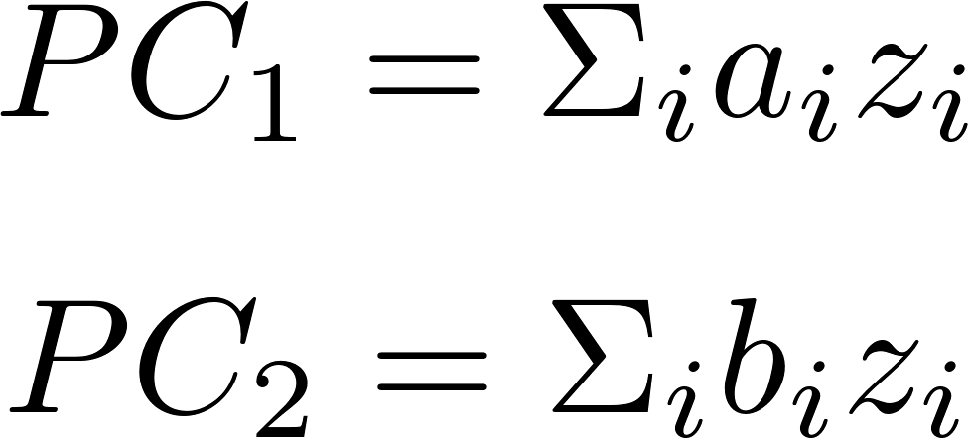
Unsupervised Fraud Algorithm, NY Data
Build expert variables that quantify signals for various fraud modes
Z scale to prepare for feature selection/dimensionality reduction
Reduce dimensions via PCA
~10¹
~10²
Original
data
Expert
variables
(x’s)
~10⁶
~10⁶
~10²
~10²
x1 …. xn
x1 …. xn
z1 …. zn
z1 …. zn
~10⁶
…
…
~10⁶
…
…
~10²
~10¹
z1 …. zn
z1 …. zn
PC₁ …. PC_{n}
PC₁ …. PC_{n}
~10⁶
…
…
~10⁶
…
…
…

Slide 72
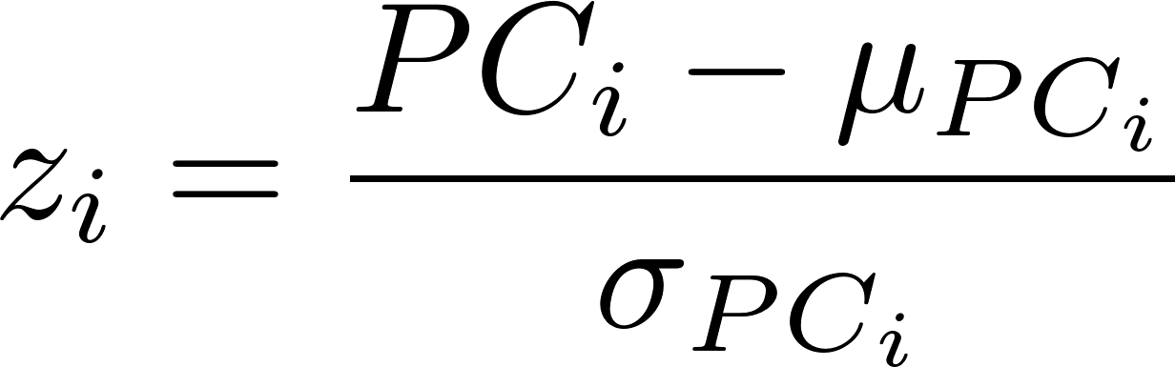
Unsupervised Fraud Algorithm continued
z scale the reduced variables (the PC’s)
The fraud score is any function of these z scores:
~10¹
~10¹
PC₁ …. PC_{n}
PC₁ …. PC_{n}
z1 …. zn
z1 …. zn
~10⁶
…
…
~10⁶
…
…
or
train an autoencoder on all the data to reproduce the z scaled PC records
the fraud score is any measure of difference between the original input record and the autoencoder output record, for example
Note that these score formulas are identical; The first finds the distance from the origin

Slide 73
Project 1 High-Level Plan
We will look for unusual valuations on the fields FULLVAL, AVLAND and AVTOT
We will build special variables to as best as possible scale these value fields to look for anomalies
We will scale by lot area, building area, and building volume, grouped by different entities
Use a small random subset of the data to get your code working and tuned. Periodically use the entire data to make sure it works.

Slide 74
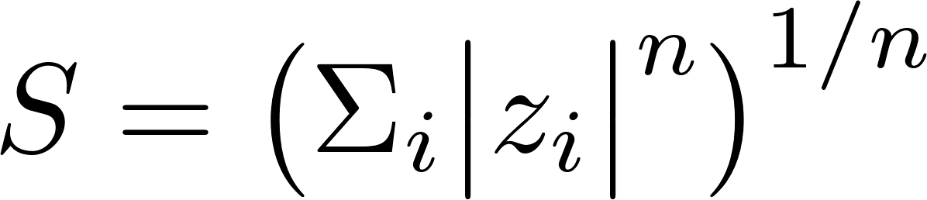
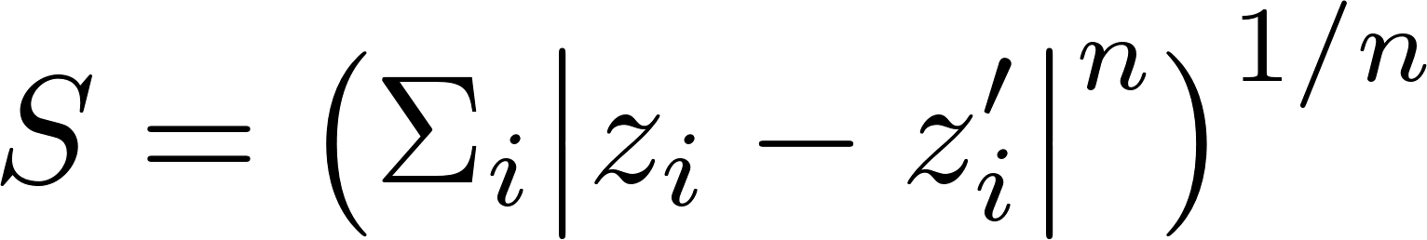
Project 1 Steps
Build ~50 “expert variables” by various scalings of the three value fields FULLVAL, AVLAND, AVTOT
Z-scale all variables
Perform PCA, keep the top 6 – 8 PC’s
Z-scale again
Build two separate fraud algorithms:
Outlier detection via z-scores:
Autoencoder error:
Combine scores via weighted quantile-scaled scores
Examine top records
Write report

Slide 75
Project 1 Variables
Create these 3 sizes
lotarea = LTFRONT * LTDEPTH
bldarea = BLDFRONT * BLDDEPTH
bldvol = bldarea * STORIES
Calculate 9 variables, each of the 3 values normalized by each of these 3 sizes (3 * 3 = 9)
Create the grouped averages of these 9 variables, grouped by
zip5, zip3, taxclass, borough, all
This makes 9 * 5 = 45 variables
Add any additional variables you can think of that make sense, if you want.
Notes:
When grouping, make sure have enough data in the bin, otherwise move up the hierarchy
Some variables are used fro calculating hyper variable, and not used in it’s original form
Scaled by all is pretty much by none
Zip5 : first 5 digits in zip
Zip3: first 3 digits in zip
Since we are targeting at 3 numeric variables, we can actually build risk tables on categorical variables.

Slide 76
Fill In Missing Fields
For the three values, when they are missing we want to fill in with innocuous values that won’t set off the alarm. Use the field averages, and you can group by any entity you think makes sense.
For the other fields we need to scale (LTFRONT, LTDEPTH, STORIES, BLDFRONT, BLDDEPTH), fill in with values that make sense. You can use whatever logic you want, for example:
If LTFRONT=LTDEPTH=0, set them to (30, 100)
If BLDFRONT=BLDDEPTH=0, set them to (20, 40)
If STORIES=0, set it to average stories by zip code, borough, TAXCLASS, or some other entity.
Notes:
Principle: don’t drop it, customers won’t like it. Fill with neutral values.
A missing value could be a signal of fraud, we ignore it for now (I think we can create a variable as a sum of number of missing values/ values that divided by zero)
If a missing value average doesn’t make sense (like zip code), can fill with population mean

Slide 77
Ask Teams How They’re Doing
Number teams
Notes:
Follow all steps?
Defend all the actions?
Decision make sense?
Clear explanation, no ambiguity (choice of m in distance)

